Slide 1
RoboCup 2019
Roadmap
Prepared by: Dina Helal

Slide 2
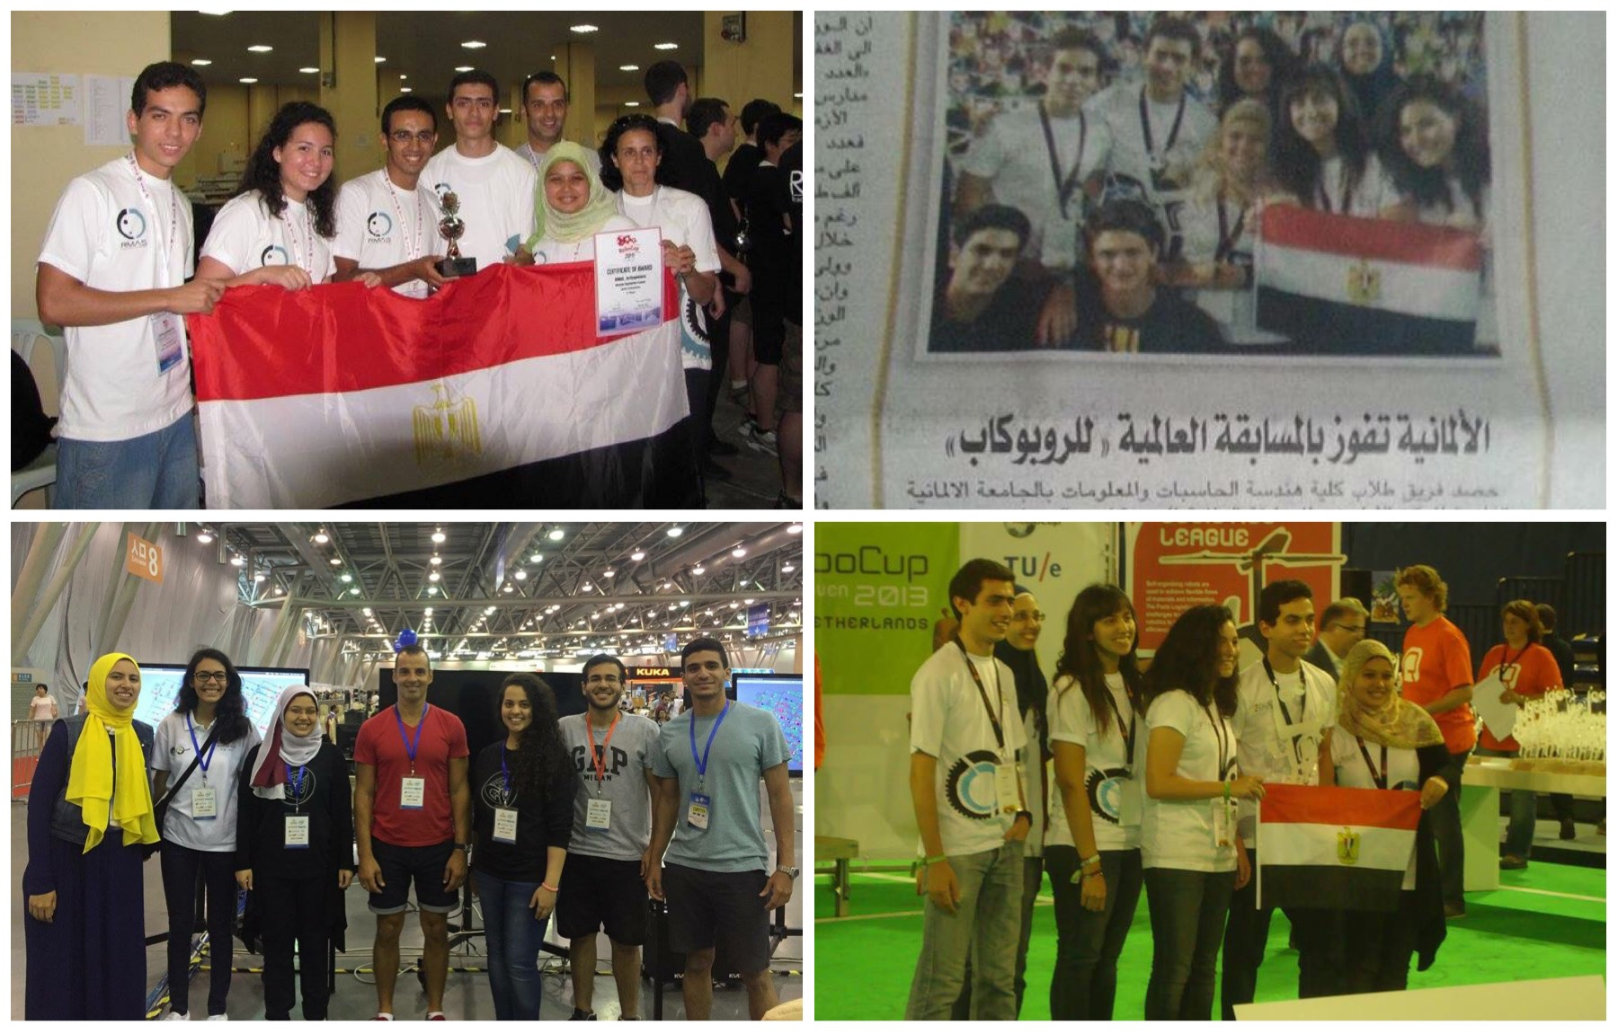
History of GUC participation in RoboCup
https://www.facebook.com/GUCRMAS/

Slide 3
History of GUC participation in RoboCup
2011 Turkey (3rd Place) - our team name was RMAS 2017 Japan (TDP accepted)
2012 Mexico (Preliminary) 2018 Canada (N/A)
2013 Netherlands (1st Place) 2019 Australia (?)
2014 Brazil (Semi-finals)
2015 China (Semi-finals)
2016 Germany (Semi-finals)

Slide 4
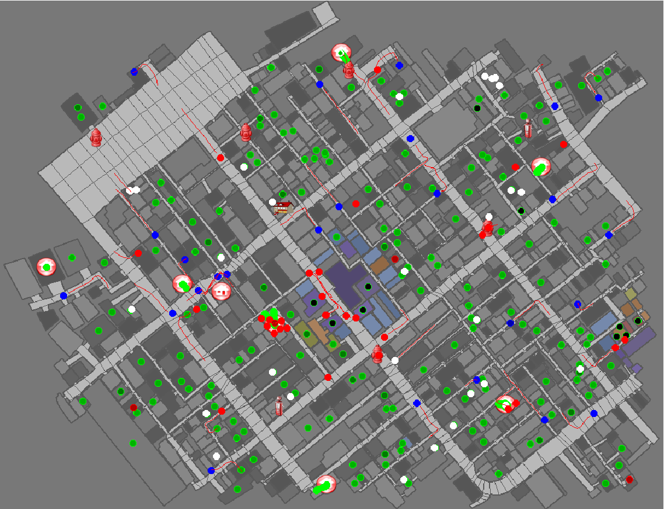
Simulator Modules
Clustering (applies to all agents)
Path planning (applies to all agents)
Target selection
Fire brigade (fire extinguishing)
Ambulance (rescuing civilians)
Police (clearing road blockades)

Slide 5
Important Notes
RoboCup is NOT a course, it doesn’t have tutorials
Self learning Self learning Self learning
Criticism is welcome at any point
Please send your preference using this form regarding joining a specific component and/or working with specific team members by Thursday October 18th.
Kindly note that your preference might not be met due to different factors that we need to take into consideration while forming the teams.
You can reach me at:
rmas.guc.reg@gmail.com
dina.helal@guc.edu.eg
You will find here all the documents related to RoboCup this year including the steps to setup the environment and the TDPs of the previous years.

Slide 6
Roadmap
Kickoff meeting ✓ | Monday 15th October 2018
Teams request deadline ✓ | Thursday 18th October 2018
Teams announcement ✓ | Sunday 21st October 2018
TDPs review + (environment setup) | Thursday 8th November 2018
Teams’ proposals | Thursday 22nd November 2018
Implementation phase I (1st Demo) | Thursday 13th December 2018
Integration phase I (2nd Demo) | Thursday 20th December 2018

Slide 7
Roadmap (cont’d)
TDP submission | TBD
Implementation phase II (3rd Demo) | TBD
Integration phase II (4th Demo) | TBD
Iran Open | TBD
Portuguese Open | TBD
Camera-ready TDP submission | TBD

